Slide 1

Opening a venue in London, canada

Slide 2
Introduction
London is a city in southwestern Ontario, Canada, along the Quebec City–Windsor Corridor.
Population: 383,822 according to the 2016 Canadian census
A regional centre of healthcare and education, being home to the University of Western Ontario (which brands itself "Western University"), Fanshawe College, and several hospitals (including a University Hospital)
London's university and hospitals are among its top ten employers. London lies at the junction of Highway 401 and 402, connecting it to Toronto, Windsor and Sarnia. It also has an international airport and train and bus stations
The city hosts a number of musical and artistic exhibits and festivals, which contribute to its tourism industry, but its economic activity is centred on education, medical research, insurance, and information technology
Wonderland Road is a major north-south arterial road in London, Ontario, designated as Ontario Highway 4 between Highway 401 and Sunningdale Road. Outside of the City limits, the road extends north into Middlesex Centre as Middlesex County Road 56 and south into Southwold. It is one of the busiest roads in London, carrying over 43,000 vehicles per day between Springbank Drive and Riverside Drive as of 2013.

Slide 3
Cost of living
The cost of living is low compared to other southern Ontario cities
The average price of a home in the London and St. Thomas area in 2016 is $274,383, which is substantially lower than the national average of $467,082.
The average price is also well below the average home prices of nearby cities including Toronto ($736,670), Hamilton ($510,204), and Kitchener-Waterloo ($364,290).
The 2015 average rental rate for a one-bedroom apartment is $781.

Slide 4
Problem statement
Given the fact that London, Ontario has a relatively small population (383,822 according to the 2016 Canadian census), what kind of potential does the city have to set-up a lucrative enterprise?
Where is it the most suitable place to establish a new business?
Where would be the cheapest but still popular place to open this business without being overwhelmed by the competitors?
The general rule is that the farther we are from the city centre, the less expensive the places are and the less overwhelming the competition is.

Slide 5
Data
In order to answer the above questions, data on London, Ontario districts to include boundaries, latitude, longitude as well as venue specifics are required.
The data will be acquired:
Wikipedia (List of postal codes in Canada)
http://cocl.us (Geodata)
FourSquare API via the Request library in Python

Slide 6
Methodology
1. General data collection about the location London, Ontario
The data will be collected from Wikipedia (https://en.wikipedia.org/wiki/List_of_postal_codes_of_Canada:_M)
The data will be cleaned and processed into a dataframe
The geodata will be collected from https://cocl.us
The data will cleaned and processed into a dataframe.
2. Data collection about the restaurants in 3 different areas (districts)
FourSquare will be used to locate all venues. The specifics of the different venues are added to the dataframe.
Finally, the data will be visually assessed using graphing from Python libraries.
3. Choosing the optimal area (district) to open the venue
Data will be sorted based on rankings and location specifics.

Slide 7
Data collection about the restaurants in 3 different areas (districts)
Horton Street (city centre/Downtown)
Wonderland Road (North-Western part of the city)
Commissioners Road (South-Eastern part of the city) – near Victoria Hospital

Slide 8
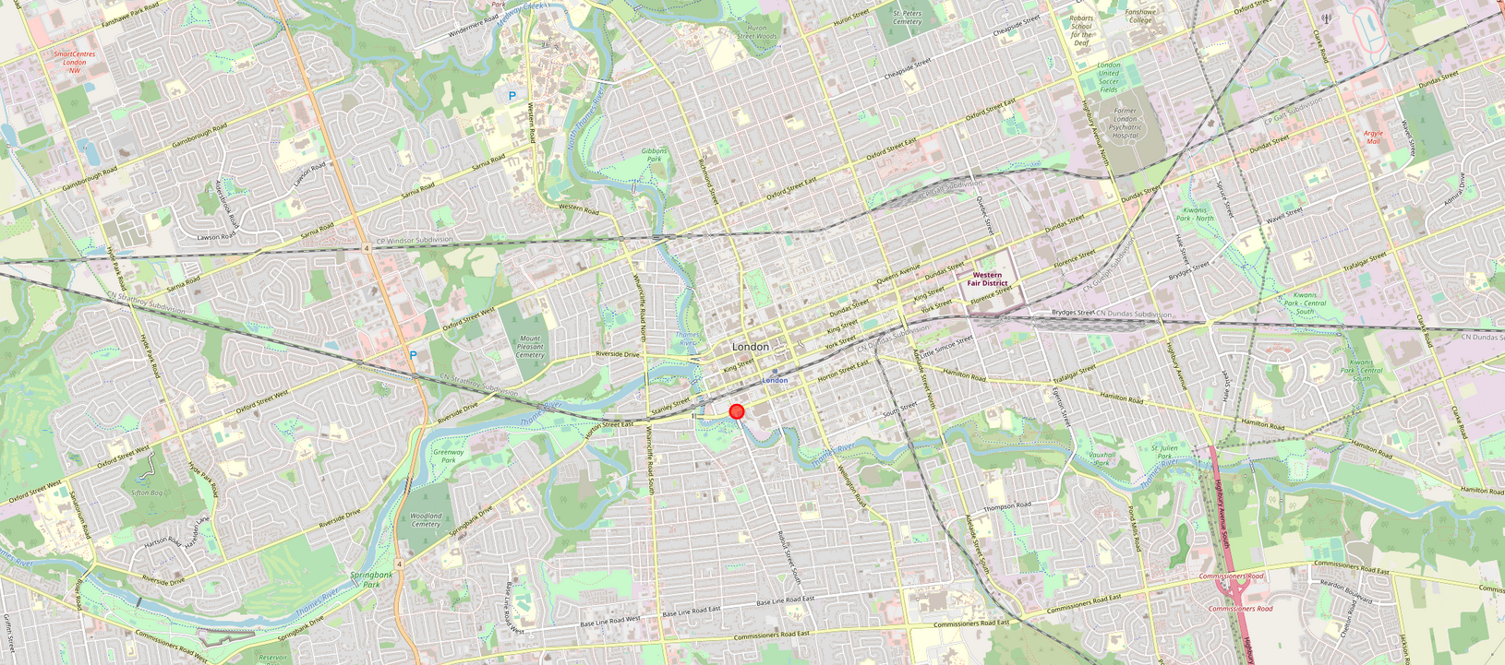
Horton Street

Slide 9
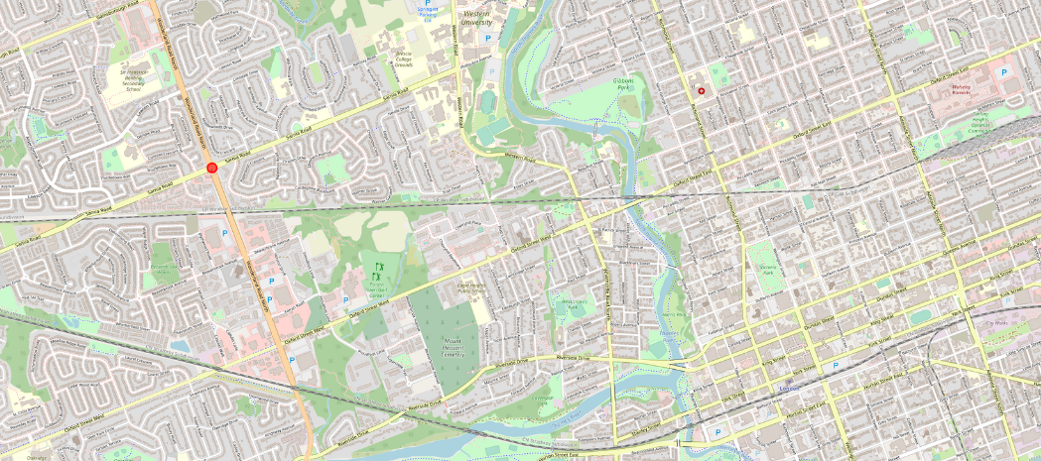
Wonderland Road (North-Western part of the city)

Slide 10
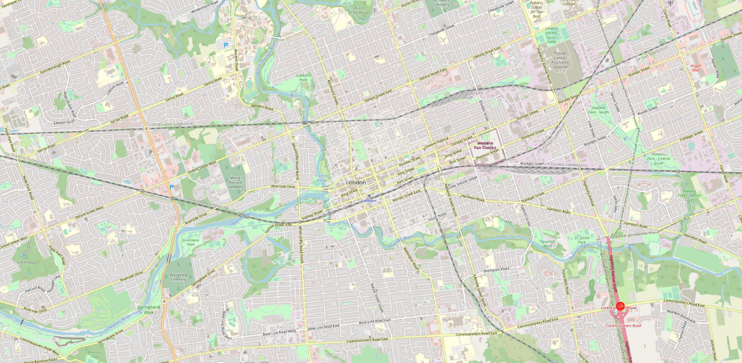
Commissioners Road (South-Eastern part of the city) - near Victoria Hospital

Slide 11
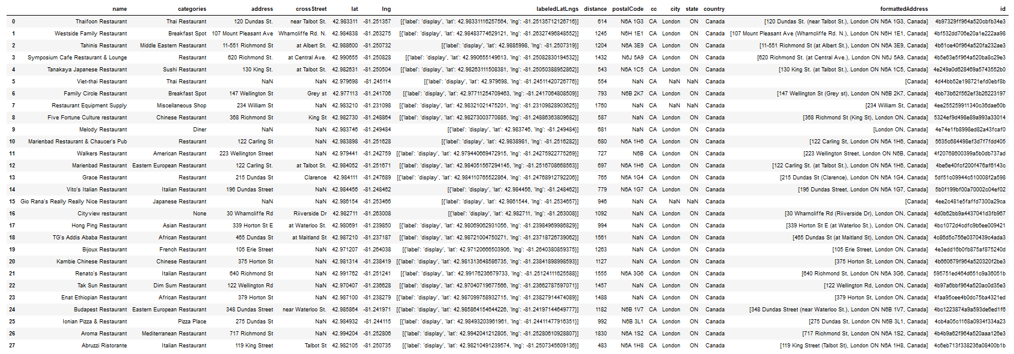
Results (Horton Street)
Firstly, I retrieved the results for the location Horton Street (found in the city centre). Based on the retrieved data there are 28 venues in the radius of 1500.
Most of the venues belong to the category restaurant.
Most of the restaurants offer Asian food (at least 6 by the name ‘Thai”, “Chinese”, “Japanese”, “Sushi”), while some of them offer Italian food (at least 3 by the name of “Italian”).
The exact type of the other restaurants offers either Middle Eastern, Eastern European, African, Mediterranean, French, American, etc. food or the cuisine is not even specified by the Category.

Slide 12
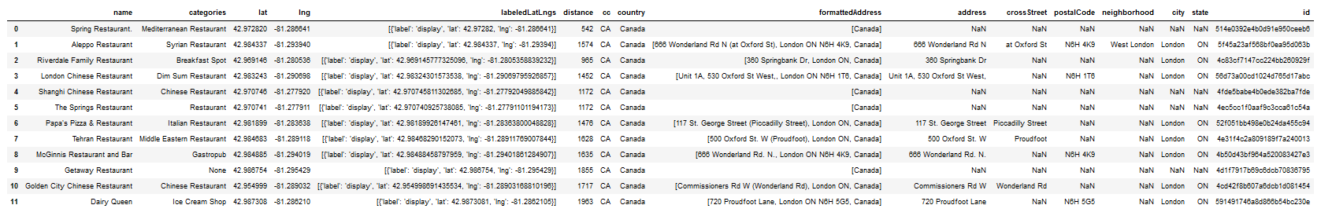
Results (Wonderland Road)
Secondly, I retrieved the results for the location Wonderland Road (found in the North-Western part of the city).
Based on the retrieved data there are 12 venues in the radius of 1500.
Most of the venues belong to the category restaurant. The composition of the restaurants is quite mixed.
There are restaurants which offer Asian food (2 by the name “Chinese”), some of them offer Italian food (1 by the name of “Italian”), while others offer other delicacies from other cuisines or is not even specified by the category restaurant.

Slide 13
Results (Commissioners Road)
Finally, in the South-eastern part of the city there is only one restaurant nearby which is an American restaurant with the name of Fireside Family Restaurant.

Slide 14
Conclusion
Taking the 3 different locations into consideration, I would open a Hungarian restaurant on Wonderland Road (in the North-Western part of London) because it is one of the busiest roads in the city London and there are already 9 different venues offering the specialties of their cuisines around the world (Asian, Italian, Syrian, Middle Eastern) apart from the Gastropub, Breakfast Spot and Ice Cream Shop venues.
Opening a Hungarian restaurant would make the variety of the already existing venues more colorful and thanks to the central location of Wonderland Road there would be enough demand to satisfy the local needs and be profitable.

